Slide 1

Word Representation and Vectorization: Word Embeddings
Namig Abbasov
Data Science and Analytics Unit
Arizona State University

Slide 2
Text Transformation: Putting Text into Structure Data
Vectorization / Transformation Types
Bag of Words (BoW)
Term Frequency-Inverse Document Frequency (TF-IDF)
Word Embeddings (like Word2Vec or GloVe).
Document Term Matrix/Document Feature Matrix
Vectorization / Transformation
converts text from its original form into a format that is more suitable for analysis

Slide 3
Problems with Bag of Words
Loss of Order Information
Lack of Context/Homonyms and Polysemy/Synonyms
Handling Negations
Sparse Representations/Scalability
Harder to model
Huge amount of weights
“cat sat on mat” vs “mat sat on cat”
"cat", "sat", "mat"
No Semantic Meaning
human language is not a bag of words!
lead, bank, joyful, elated

Slide 4

Why Word Embeddings?
Natural Human Language
Synonyms
Paraphrasing
Analogies
Polysemy
Word embeddings aim to represent text in a way that maintains patterns of thought and reasoning in text data
Connections in meanings

Slide 5

“You shall know a word by the company it keeps!” John Rupert Firth

Slide 6
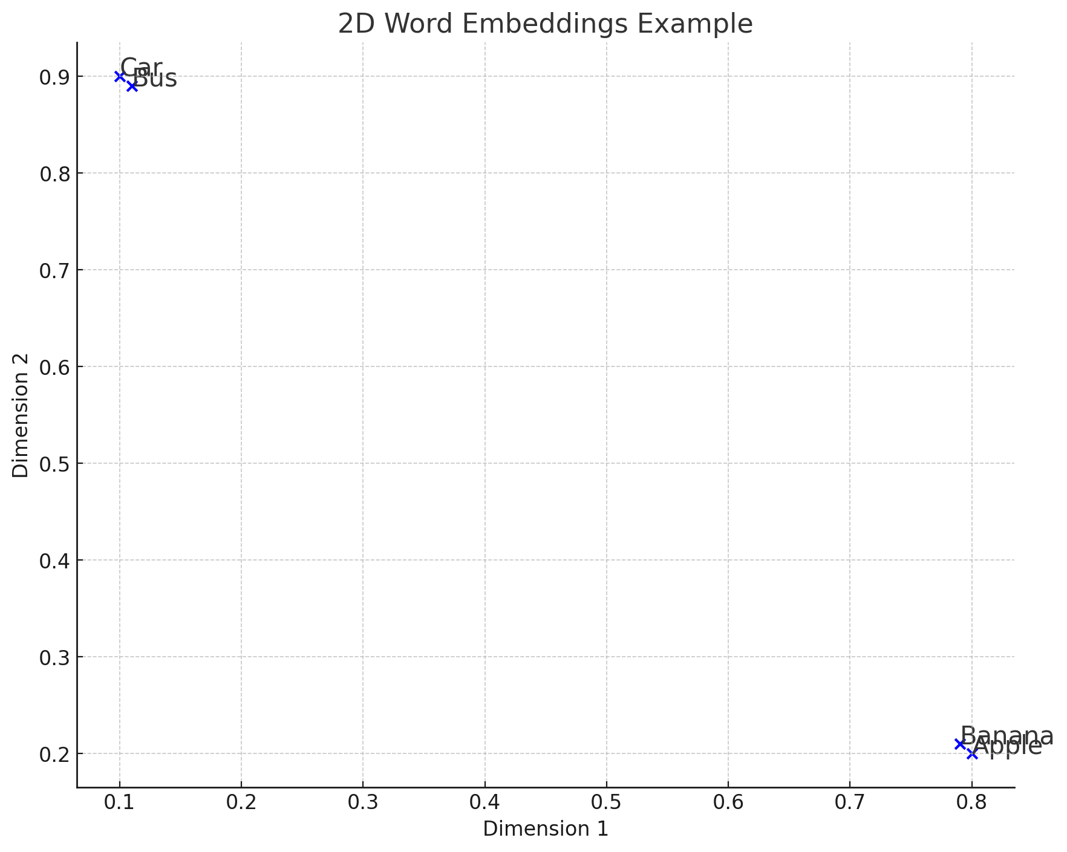
Embedding Words into Vector Spaces
Context Over Counts: Assess contexts in which words co-occur, beyond frequency.
Vector Space Embedding: Utilize patterns of co-occurrence to map each word into an N-dimensional vector space, effectively "embedding" terms into this space.
Visual Analogy: If visualized in two dimensions, this embedding is similar to plotting locations on a map using latitude and longitude.
Example: Like measuring the distance from Phoenix to Flagstaff, we can quantify the "distance" between any two words in this space, revealing their relationship.
Insight: Closer "distances" between words (e.g., Phoenix is closer to Flagstaff than Portland) signify stronger contextual relationships or similarities.
Word Embedding Example
"Apple" embedded as [0.8, 0.2]
"Banana" embedded as [0.79, 0.21]
"Car" might be embedded as [0.1, 0.9]
"Bus" might be embedded as [0.11, 0.89]

Slide 7
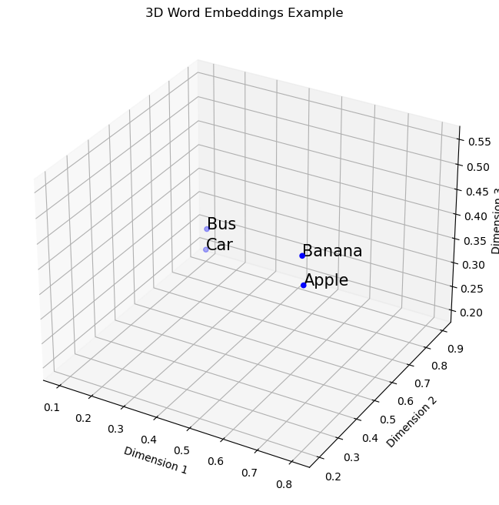
Embedding Words into Vector Spaces: 3D
"Apple": [0.8, 0.2, 0.5],
"Banana": [0.79, 0.21, 0.55],
"Car": [0.1, 0.9, 0.2],
"Bus": [0.11, 0.89, 0.25]

Slide 8
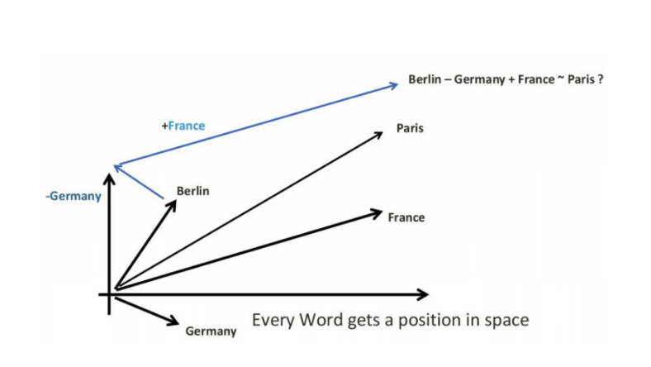
Arithmetic on Embeddings to Derive meaning
Arbitrary 2D vectors:
Berlin: [2, 1]
Germany: [2, 2]
France: [0, 1]
Compute Paris:
Start with Berlin: [2, 1]
Subtract Germany: [2, 1] - [2, 2] = [0, -1]
Add France: [0, -1] + [0, 1] = [0, 0]

Slide 9
Word Embeddings Models
Traditional Word Embeddings
word2Vec by Google 2013
skip-gram
CBOW (Continuous Bag of Words)
GloVe by Stanford University 2014
Document embeddings: doc2vec
extension of word2vec
inclusion of character n-grams
FastText by Meta
extension of word2vec
ELMo (Embeddings from Language Models)
deep bidirectional LSTM (Long Short-Term Memory)
Transformer-based models
BERT,
Transformer architecture
RoBERTa,
GPT
T5
Note: Traditional word embeddings are primary embeddings models in text analysis.
Others are not direct word embeddings models

Slide 10
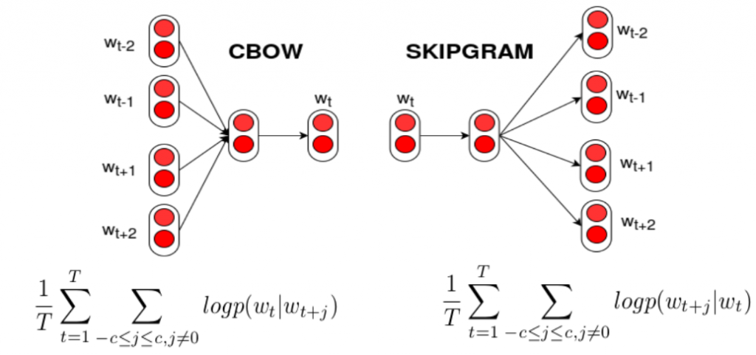
Word2Vec

Slide 11
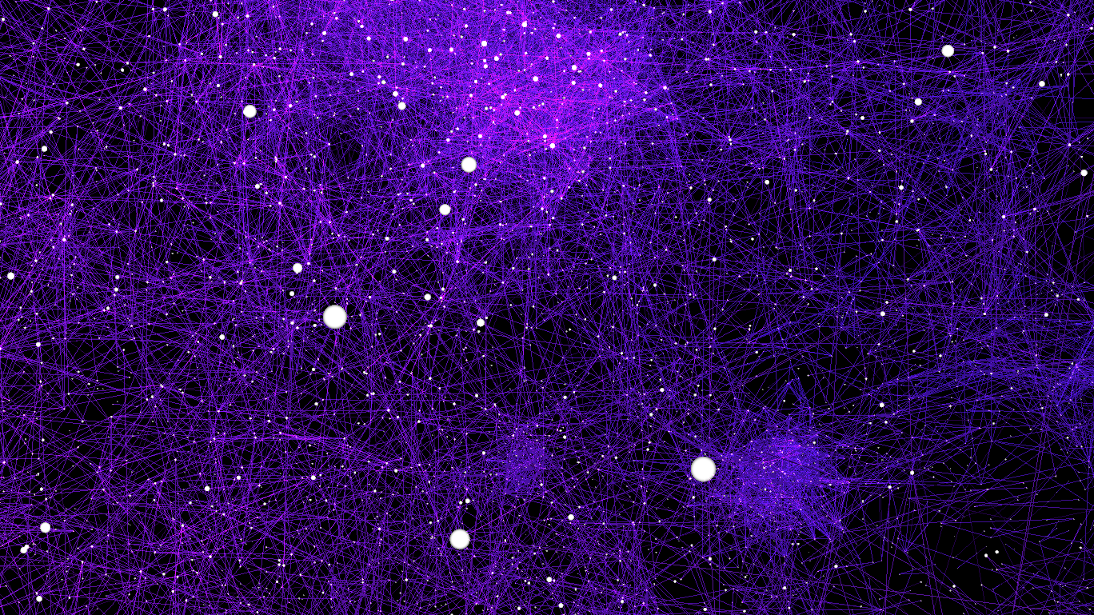
GloVe

Slide 12
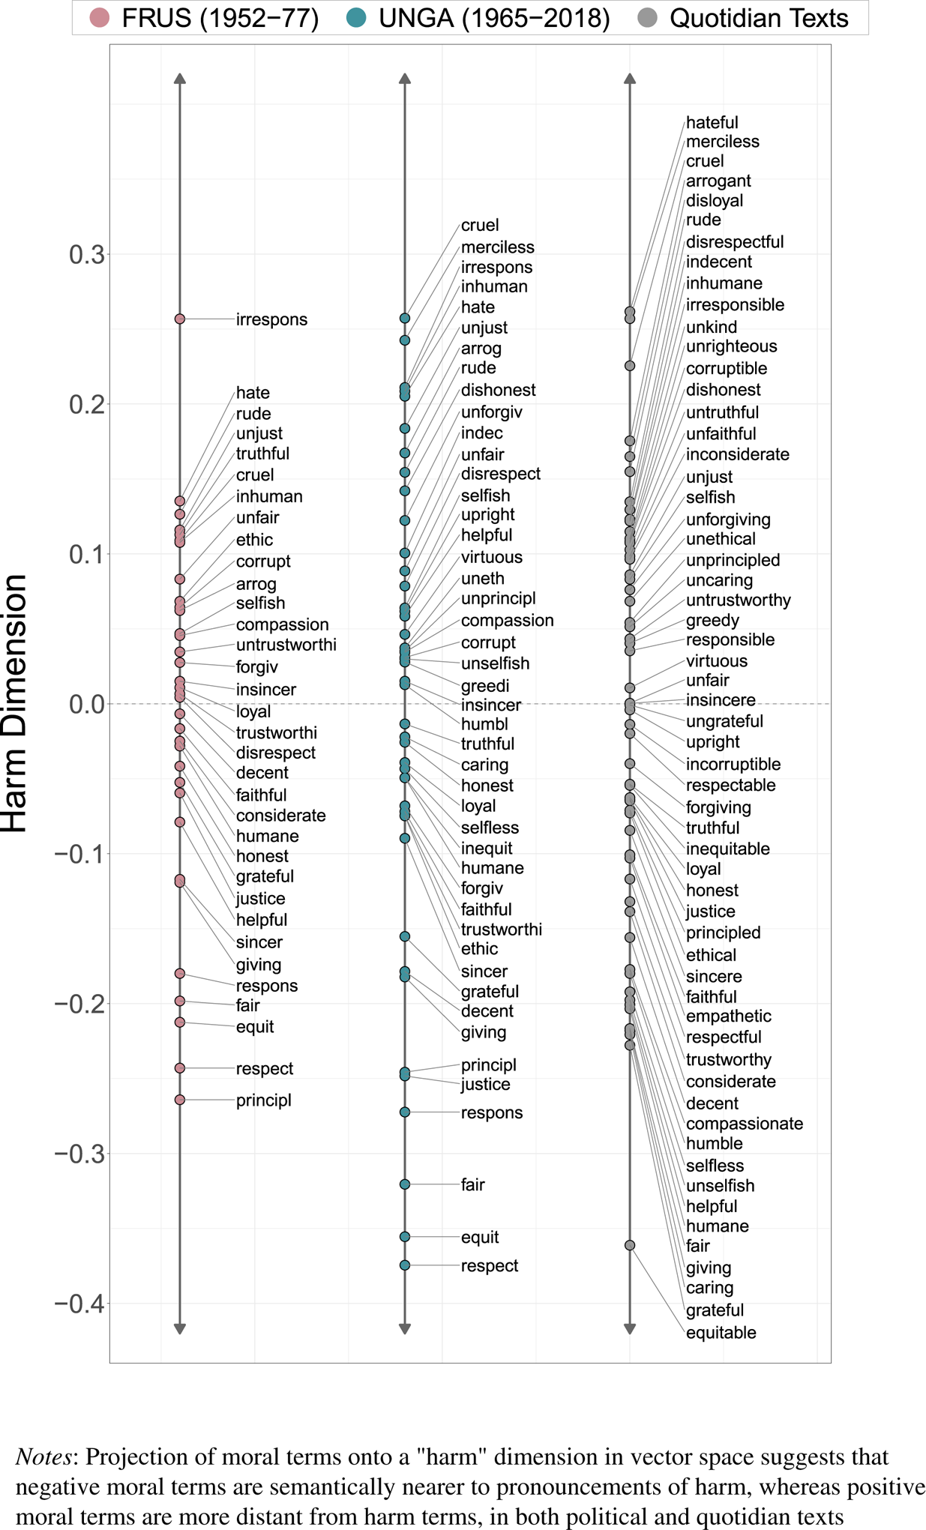
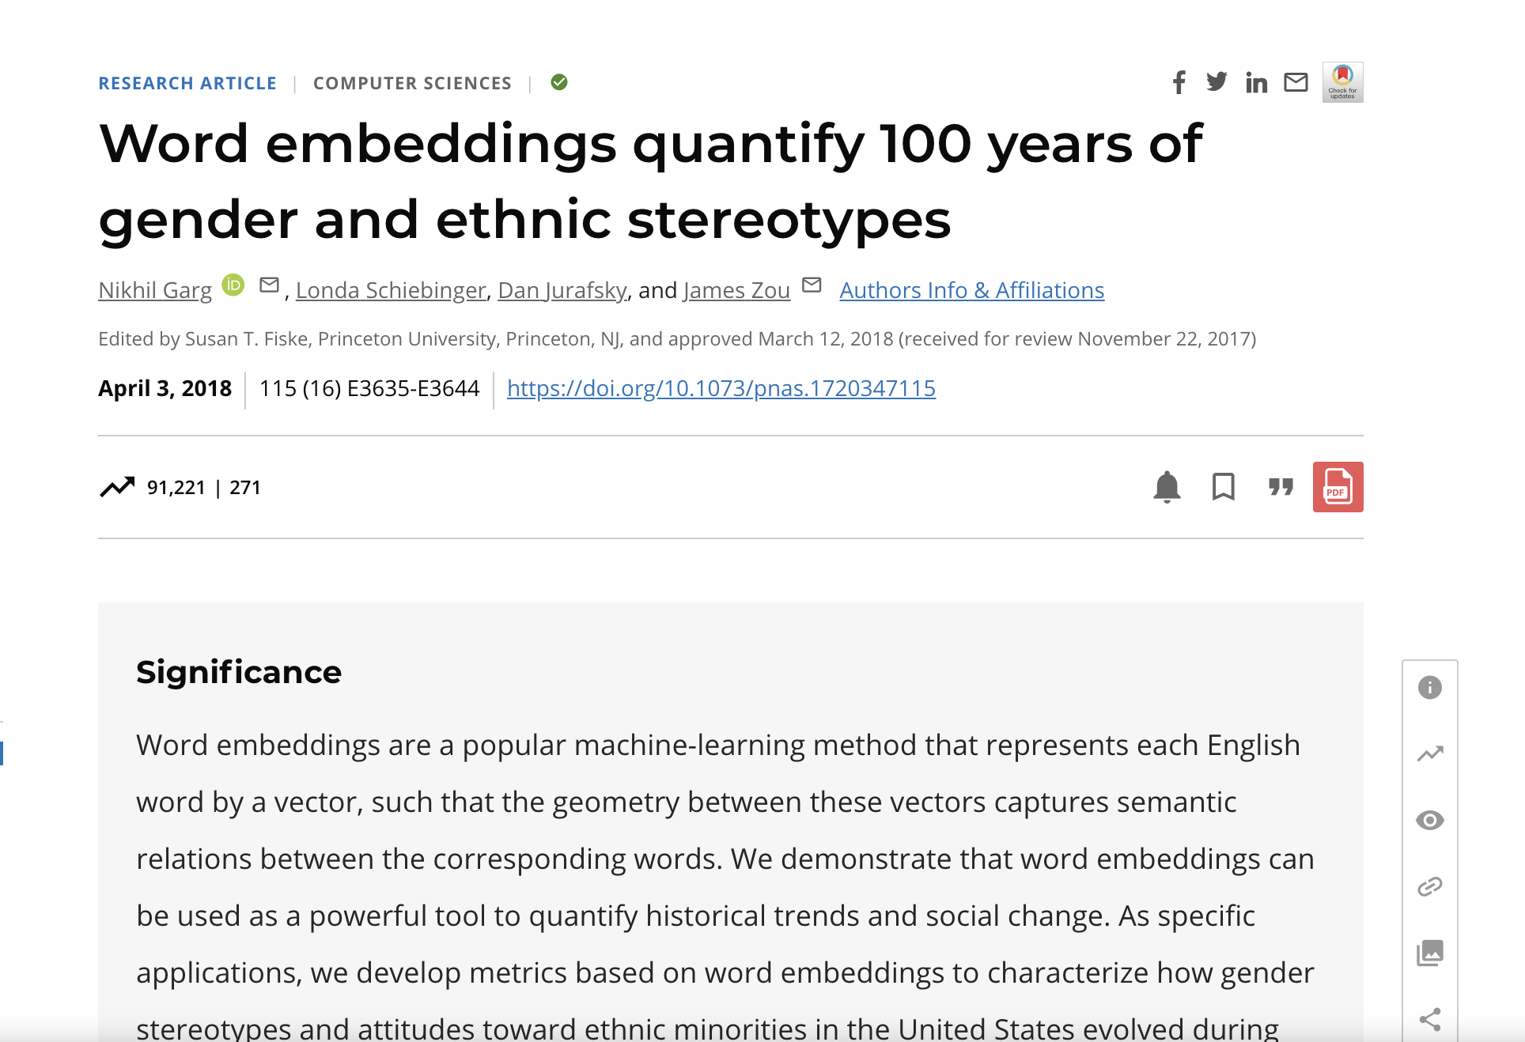
Research Using Word Embeddings

